Slide 1

REAL-TIME AUGMENTED REALITY FOR VIRTUAL TRY-ON
ADVISOR: PROF. VIJAY KUMAR ERANTI
TEAM: PRAGYA GAUTAM
MOJDEH KEYKHANZADEH
SITHARA KRISHNA MURTHY
VIDHI SHAH

Slide 2






INTRODUCTION
Goal: Provide E-commerce customers with a system that allows them to virtually try on a variety of products in real time while preserving their privacy.
Advantages:
Simple site access
At home shopping
Real-time
Multi Platform support
User Privacy

Slide 3
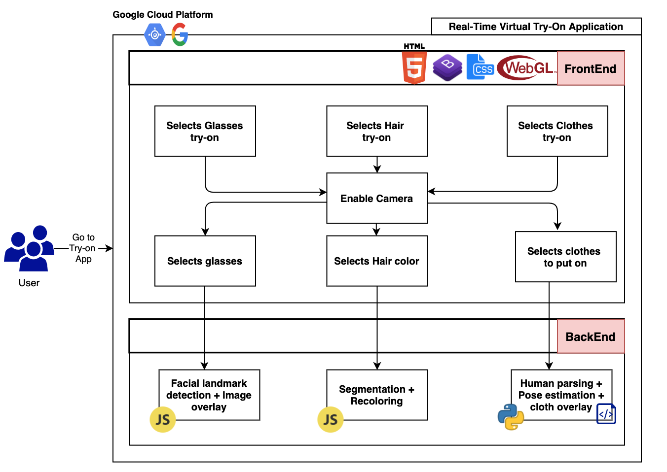
ARCHITECTURE

Slide 4
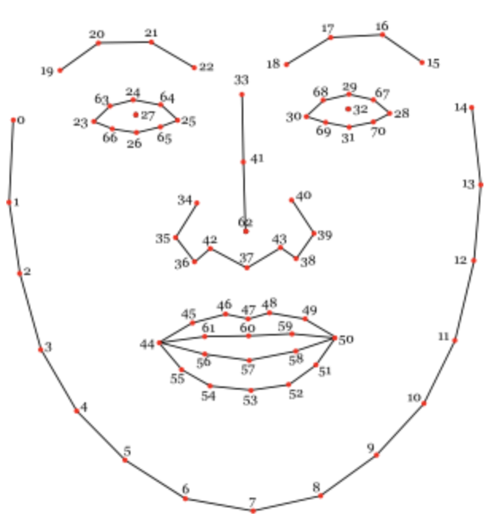
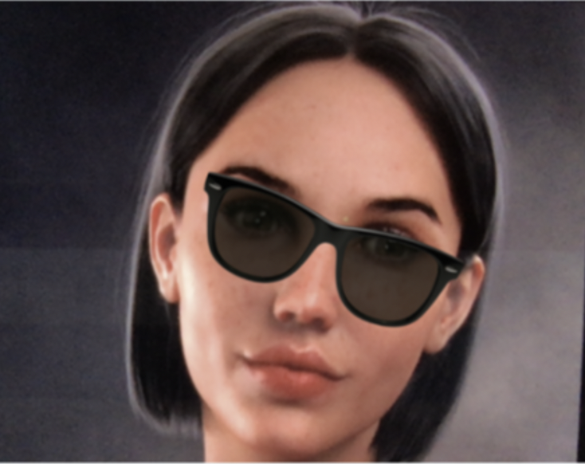
GLASSES TRY-ON
Facial Landmark Detection
CLMtrackr: To identify the position of the points of the eyes so that we can overlay the 3D glasses on the face of the customer.
Image Overlaying
Three.js: To overlay the glasses based on the position derived from CLMtrackr on the live video feed of the user.
Notes:
The users live video feed is captured and the selected glasses are overlaid on the user.
Facial Landmark Detection
CLMtrackr: To identify the position of the points of the eyes so that we can overlay the 3D glasses on the face of the customer.
Image Overlaying
Three.js: To overlay the glasses based on the position derived from CLMtrackr on the live video feed of the user.

Slide 5
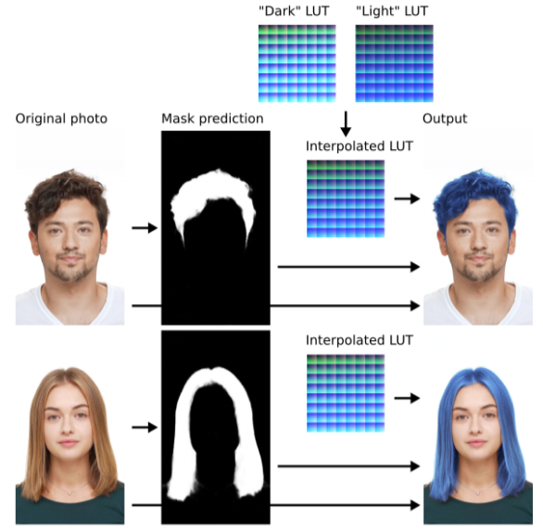
HAIR COLOR TRY-ON
Hair Segmentation
Identify hair of the user
Separate hair from the background
Hair Recoloring
Color the hair based on segments
Notes:
The users live video feed is captured and the user’s hair is turned into the color chosen by adjusting the RGB sliders.
Hair Segmentation
A segmentation model is used to identify hair of the user in their live video feed separating the hair from the background for each frame of the input.
Hair Recoloring
Hair recoloring can be done, once the segments are obtained for an image.

Slide 6
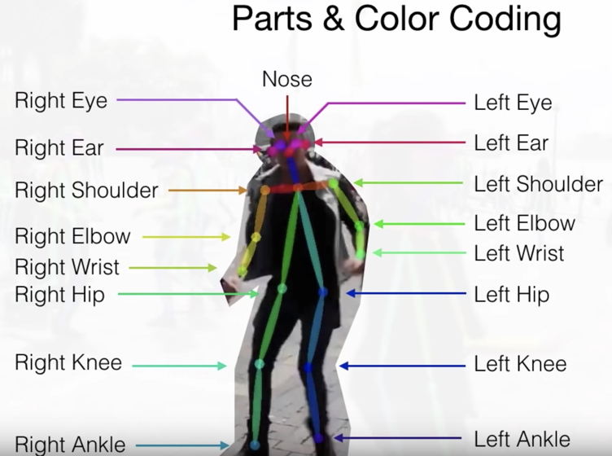
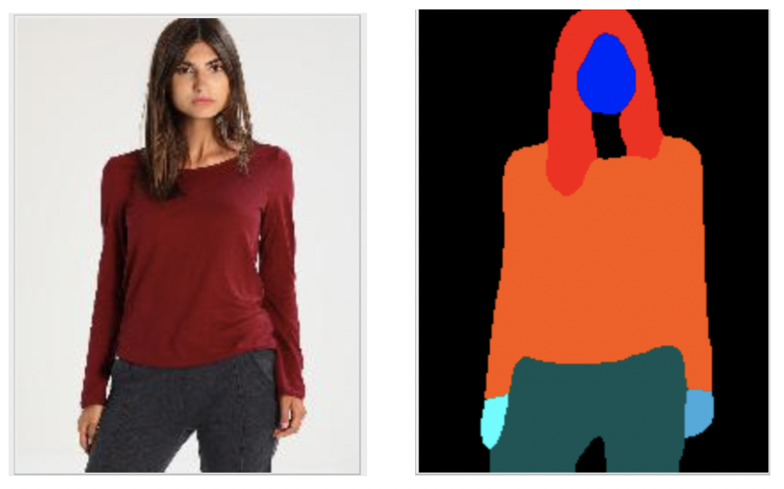
CLOTHS TRY-ON
Human Parsing
JPPNet: The parsing model will identify the different segments of the body, such as, head, arms, legs, ect.
Pose Estimation
VGG19 & CNN: Model will determine the body points in the human pose.
Clothing Transfer
VITON Stage-1: responsible to do the inference by determining the mask to be put on a person's image based on body points and sample clothing to put on.
VITON Stage-2: further refinement on the generated results from the stage-1 and generate the final results.
Notes:
The user captures an image of themselves from a live video, selects a clothing of their choice and can try it on.
Human Parsing
JPPNet: The parsing model will identify the different segments of the body, such as, head, arms, legs, ect.
Pose Estimation
VGG19 & CNN: Model will determine the body points in the human pose.
Clothing Transfer
VITON Stage-1 is responsible to do the inference by determining the mask to be put on a person's image based on body points and sample clothing to put on.
VITON Stage-2 will do further refinement on the generated results from the stage-1 and generate the final results

Slide 7
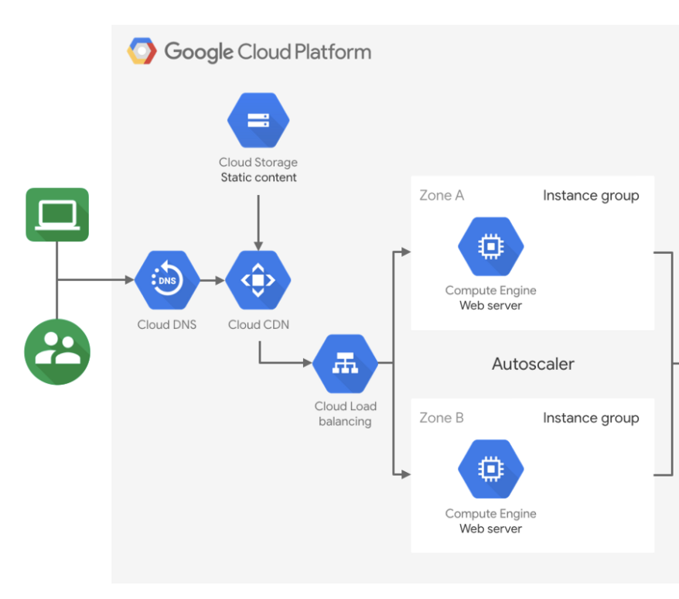
DEPLOYMENT
Deployed over Google Compute Engine
Configuration
Machine : n1-standard-8
8 virtual CPUs
30GB memory
Ubuntu 18.04 OS
Firewall open for both HTTP/HTTPS traffic
Notes:
The entire web application, including both front-end and back-end is deployed within the google compute engine (GCE) instances. It automatically scales the application. Instances can be started or stopped as per the need.
Configuration
Machine : n1-standard-8
8 virtual CPUs
30GB memory
Ubuntu 18.04 OS
Firewall open for both HTTP/HTTPS traffic

Slide 8



CONCLUSION
Deep learning solution for virtual try on for a catalogue of products
Focus Areas
Glasses try on
Hair coloring
Clothes try on
Application Customers
E-commerce Giants (Walmart, Amazon, eBay, etc.)
Small mom and pop shops
Notes:
In this project, we provide a solution for virtual try on for a catalogue of products.
The three products focused on are glasses, hair coloring and clothing.
This is achieved using pre-trained models for facial landmark detection, hair segmentation, human parsing and pose estimation respectively.
We have created an application that can be very beneficial to not only big e-commerce companies, such as, Walmart, Amazon, Ebay, etc. but also to small mom and pop shops.

Slide 9


FUTURE WORK
Provide support for more products such as makeup and jewelry
Use of different types of Generative Adversarial Networks for the implementation

